Slide 1
MEMORY SYSTEM ORGANIZATION AND ARCHITECTURE

Slide 2
CPU-Main Memory Connection
Processor
k
-bit
Memory
address bus
MAR
n
-bit
data bus
Up to 2
k
addressable
MDR
locations
Word length =
n
bits
Control lines
R
/
W
( , MFC, etc.)

Slide 3
The processor reads data from the memory by loading the address of the required memory location into the MAR register and setting the R/W line to 1. The memory responds by placing the data from the addressed location onto the data lines, and confirms this action by asserting the MFC(Memory Function Completed) signal. Upon receipt of the MFC signal, the processor loads the data on the data lines into the MDR register.
The processor writes data into a memory location by loading the address of this location into MAR and loading the data into MDR. It indicates that a write operation is involved by setting the R/W line to 0.

Slide 4
Measures for the speed of a memory:
memory access time-how long it takes for a character in memory to be transferred to or from the CPU.
memory cycle time-minimum time interval between two successive accesses.
An important design issue is to provide a computer system with as large and fast a memory as possible, within a given cost target.
Several techniques to increase the effective size and speed of the memory:
Cache memory (to increase the effective speed).
Virtual memory (to increase the effective size).

Slide 5
Memory Hierarchy
Pr
ocessor
Fastest access is to the data held in
processor registers. Registers are at
the top of the memory hierarchy.
Relatively small amount of memory that
can be implemented on the processor
chip. This is processor cache.
Two levels of cache. Level 1 (L1) cache
is on the processor chip. Level 2 (L2)
cache is in between main memory and
processor.
Next level is main memory.
Much larger, but much slower
than cache memory.
Next level is magnetic disks. Huge amount
of inexepensive storage.
Speed of memory access is critical, the
idea is to bring instructions and data
that will be used in the near future as
close to the processor as possible.
Re
gisters
Increasing
Increasing
Increasing
size
speed
cost per bit
Primary
L1
cache
Secondary
L2
cache
Main
memory
Magnetic disk
secondary
memory

Slide 6
The Memory System
Semiconductor RAM memories

Slide 7
Internal organization of memory chips
Each memory cell can hold one bit of information.
Memory cells are organized in the form of an array.
One row is one memory word.
All cells of a row are connected to a common line, known as the “word line”.
Word line is connected to the address decoder.
The cells in each column are connected to a Sense/Write circuit by two bit lines.
Sense/write circuits are connected to the data input/output lines of the memory chip.

Slide 8
During a read operation, these circuits sense or read the information stored in the cells selected by a word line and transmit this information to the output data lines.
During a write operation, the Sense/Write circuits receive input information and store it in the cells of the selected word.

Slide 9
Internal organization of memory chips (Contd.,)
7
7
1
1
0
0
W
0
•
•
•
FF
FF
A
0
W
1
•
•
•
A
1
Address
Memory
decoder
•
•
•
•
•
•
•
•
•
•
•
•
•
•
•
•
•
•
cells
A
2
A
3
W
15
•
•
•
Sense / Write
Sense / Write
Sense / Write
R
/
W
circuit
circuit
circuit
CS
Data input
/output lines:
b
7
b
1
b
0

Slide 10
This figure is an example of a very small memory chip consisting of 16 words of 8 bits each. This is referred to as a 16x8 organization.
The data input and the data output of each Sense/Write circuit are connected to a single bidirectional data line that can be connected to the data bus of a computer.
Two control lines, R/W input specifies the required operation and the CS(Chip Select) input selects a given chip in a multichip memory system.

Slide 11
Asynchronous DRAM
Static RAMs (SRAMs):
Consist of circuits that are capable of retaining their state as long as the power is applied.
Volatile memories, because their contents are lost when power is interrupted.
Access times of static RAMs are in the range of few nanoseconds.
However, the cost is usually high as their cells require several transistors.
Dynamic RAMs (DRAMs):
Do not retain their state indefinitely.
Contents must be periodically refreshed.
Contents may be refreshed while accessing them for reading.

Slide 12
16 Megabit DRAM chip
R
A
S
Row
Row
4096
×
(
512
×
8
address
)
latch
decoder
cell array
A
20
⁄
A
Sense / Write
CS
-
9
8
-
0
circuits
R
/
W
Column
Column
address
decoder
latch
C
A
S
D
D
7
0

Slide 13
The cells are organized in the form of a 4Kx4K array.
The 4096 cells in each row are divided into 512 groups of 8, so that a row can store 512 bytes of data.
Therefore, 12 address bits are needed to select a row, and 9 bits are needed to specify a group of 8 bits in the selected row.
Thus, a total of 21 bit address is needed to access a byte in this memory.
The high- order 12 bits and the low-order 9 bits of the address constitute the row and column addresses of a byte respectively.
First apply the row address, RAS signal latches the row address. Then apply the column address, CAS signal latches the address.
Timing of the memory unit is controlled by a specialized unit called memory controller which generates RAS and CAS.

Slide 14
Fast Page Mode
Suppose if we want to access the consecutive bytes in the selected row.
This can be done without having to reselect the row.
Add a latch at the output of the sense circuits in each column.
All the latches are loaded when the row is selected.
Different column addresses can be applied to select and place different bytes on the data lines.
Consecutive sequence of column addresses can be applied under the control signal CAS, without reselecting the row.
Allows a block of data to be transferred at a much faster rate than random accesses.
A small collection/group of bytes is usually referred to as a block.
This transfer capability is referred to as the
fast page mode feature.

Slide 15
Synchronous DRAM
Refresh
counter
Row
Ro
w
address
decoder
Cell array
latch
Row/Column
address
Column
Co
lumn
Read/Write
address
decoder
circuits & latches
counter
Clock
R
A
S
Mode register
C
A
S
and
Data input
Data output
R
/
W
timing control
register
register
C
S
Data

Slide 16
DRAMS whose operation is directly synchronized with a clock signal.
A read operation causes the contents of all cells in the selected row to be loaded into these latches.
But if an access is made for refreshing purposes only, it will not change the contents of the latches, it will merely refresh the contents of the cells.
Have different modes of operation which can be selected by writing control information into a mode register.
Eg: burst operations of different lengths can be specified.
The control signals are provided internally using a column counter and the clock signal.
All actions are triggered by the rising edge of the clock.

Slide 17
Latency, Bandwidth
Memory latency is the time it takes to transfer a word of data to or from memory
Memory bandwidth is the number of bits or bytes that can be transferred in one second.

Slide 18
Memory controller
In a dynamic memory chip, to reduce the number of pins, multiplexed addresses are used.
Address is divided into two parts:
High-order address bits select a row in the array.
They are provided first, and latched using RAS signal.
Low-order address bits select a column in the row.
They are provided later, and latched using CAS signal.
However, a processor issues all address bits at the same time.
In order to achieve the multiplexing, memory
controller circuit is inserted between the processor
and memory.

Slide 19
Memory controller (contd..)
Row/Column
Address
address
R
A
S
R
/
W
Memory
C
A
S
Request
controller
R
/
W
Processor
Memory
C
S
Clock
Clock
Data

Slide 20
The Memory System
Read-Only Memories (ROMs)

Slide 21
Read-Only Memories (ROMs)
SRAM and SDRAM chips are volatile:
Lose the contents when the power is turned off.
Many applications need memory devices to retain contents after the power is turned off.
For example, computer is turned on, the operating system must be loaded from the disk into the memory.
Store instructions which would load the OS from the disk.
Need to store these instructions so that they will not be lost after the power is turned off.
We need to store the instructions into a non-volatile memory.
Non-volatile memory is read in the same manner as volatile memory.

Slide 22
Read-Only Memories (Contd.,)
Read-Only Memory:
Data are written into a ROM when it is manufactured.
Programmable Read-Only Memory (PROM):
Allow the data to be loaded by a user.
Process of inserting the data is irreversible.
Storing information specific to a user in a ROM is expensive.
Providing programming capability to a user may be better.
Erasable Programmable Read-Only Memory (EPROM):
Stored data to be erased and new data to be loaded.
Flexibility, useful during the development phase of digital systems.
Erasable, reprogrammable ROM.
Erasure requires exposing the ROM to UV light.

Slide 23
Read-Only Memories (Contd.,)
Electrically Erasable Programmable Read-Only Memory (EEPROM):
To erase the contents of EPROMs, they have to be exposed to ultraviolet light.
Physically removed from the circuit.
EEPROMs the contents can be stored and erased electrically.
Flash memory:
Has similar approach to EEPROM.
Read the contents of a single cell, but write the contents of an entire block of cells.
Flash devices have greater density.
Higher capacity and low storage cost per bit.
Power consumption of flash memory is very low, making it attractive for use in equipment that is battery-driven.
Single flash chips are not sufficiently large, so
larger memory modules are implemented using
flash cards and flash drives.

Slide 24
Speed, Size, and Cost
A big challenge in the design of a computer system is to provide a sufficiently large memory, with a reasonable speed at an affordable cost.
Static RAM:
Very fast, but expensive, because a basic SRAM cell has a complex circuit making it impossible to pack a large number of cells onto a single chip.
Dynamic RAM:
Simpler basic cell circuit, hence are much less expensive, but significantly slower than SRAMs.
Magnetic disks:
Storage provided by DRAMs is higher than SRAMs, but is still less than what is necessary.
Secondary storage such as magnetic disks provide a large amount
of storage, but is much slower than DRAMs.

Slide 25
The Memory System
Cache Memories

Slide 26
Cache Memories
Processor is much faster than the main memory.
As a result, the processor has to spend much of its time waiting while instructions and data are being fetched from the main memory.
Major obstacle towards achieving good performance.
Speed of the main memory cannot be increased beyond a certain point.
Cache memory is an architectural arrangement which makes the main memory appear faster to the processor than it really is.
Cache memory is based on the property of computer programs known as “locality of reference”.

Slide 27
Locality of Reference
Analysis of programs indicates that many instructions in localized areas of a program are executed repeatedly during some period of time, while the others are accessed relatively less frequently.
These instructions may be the ones in a loop, nested loop or few procedures calling each other repeatedly.
This is called “locality of reference”.
Temporal locality of reference:
Recently executed instruction is likely to be executed again very soon.
Spatial locality of reference:
Instructions with addresses close to a recently executed instruction are likely
to be executed soon.

Slide 28
Cache memories
Processor
Cache
Main
memory
Processor issues a Read request, a block of words is transferred from the main memory to the cache, one word at a time.
Subsequent references to the data in this block of words are found in the cache.
At any given time, only some blocks in the main memory are held in the cache. Which blocks in the main memory are in the cache is determined by a “mapping function”.
When the cache is full, and a block of words needs to be transferred
from the main memory, some block of words in the cache must be
replaced. This is determined by a “replacement algorithm”.

Slide 29
Cache hit
Existence of a cache is transparent to the processor. The processor issues Read and Write requests in the same manner.
If the data is in the cache it is called a Read or Write hit.
Read hit:
The data is obtained from the cache.
Write hit:
Cache has a replica of the contents of the main memory.
Contents of the cache and the main memory may be updated simultaneously. This is the write-through protocol.
Update the contents of the cache, and mark it as updated by setting a bit known as the dirty bit or modified bit. The contents of the main memory are updated when this block is replaced. This is write-back or copy-back protocol.

Slide 30
Cache miss
If the data is not present in the cache, then a Read miss or Write miss occurs.
Read miss:
Block of words containing this requested word is transferred from the memory.
After the block is transferred, the desired word is forwarded to the processor.
The desired word may also be forwarded to the processor as soon as it is transferred without waiting for the entire block to be transferred. This is called load-through or early-restart.
Write-miss:
Write-through protocol is used, then the contents of the main memory are updated directly.
If write-back protocol is used, the block containing the
addressed word is first brought into the cache. The desired word
is overwritten with new information.

Slide 31
Cache Coherence Problem
A bit called as “valid bit” is provided for each block.
If the block contains valid data, then the bit is set to 1, else it is 0.
Valid bits are set to 0, when the power is just turned on.
When a block is loaded into the cache for the first time, the valid bit is set to 1.
Data transfers between main memory and disk occur directly bypassing the cache.
When the data on a disk changes, the main memory block is also updated.
However, if the data is also resident in the cache, then the valid bit is set to 0.
What happens if the data in the disk and main memory changes and the write-back protocol is being used?
In this case, the data in the cache may also have changed and is indicated by the dirty bit.
The copies of the data in the cache, and the main memory are different. This is called the cache coherence problem.
One option is to force a write-back before the main memory is updated from the disk.

Slide 32
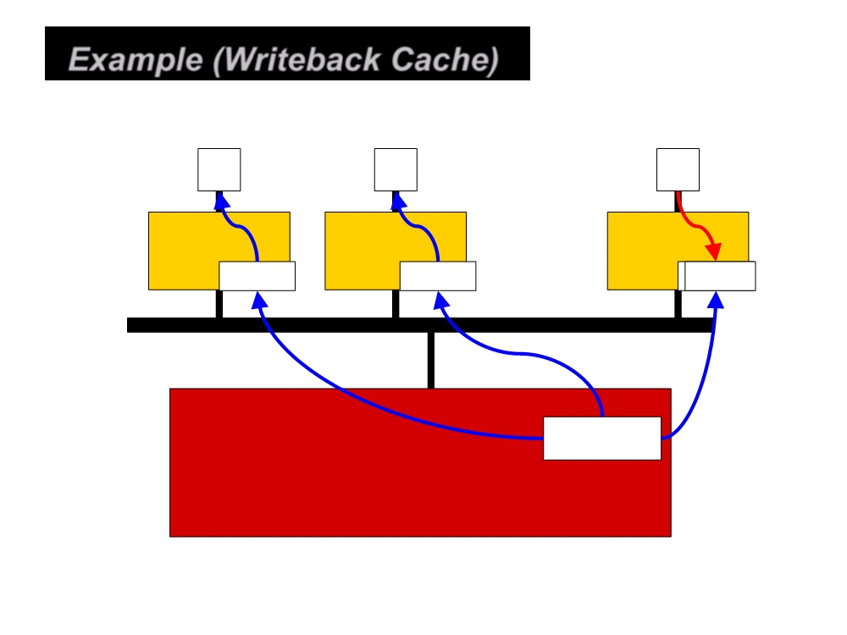
Example (Writeback Cache)
P
P
P
Rd?
Rd?
Cache
Cache
Cache
X= -100
X= -100
X= 505
X= -100
Memory

Slide 33
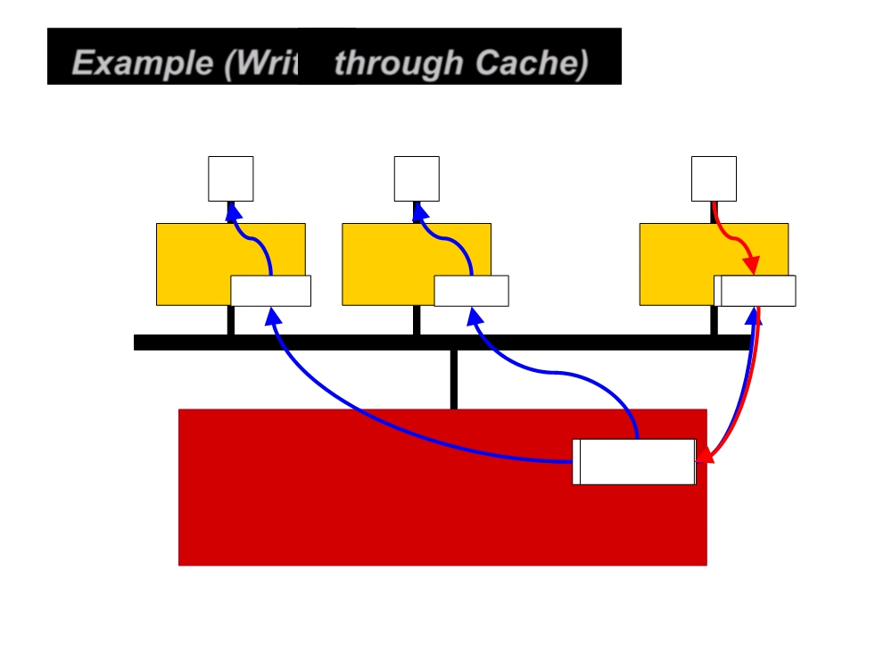
Example (Write-through Cache)
P
P
P
Rd?
Cache
Cache
Cache
X= -100
X= 505
X= 505
X= 5050
Memory

Slide 34
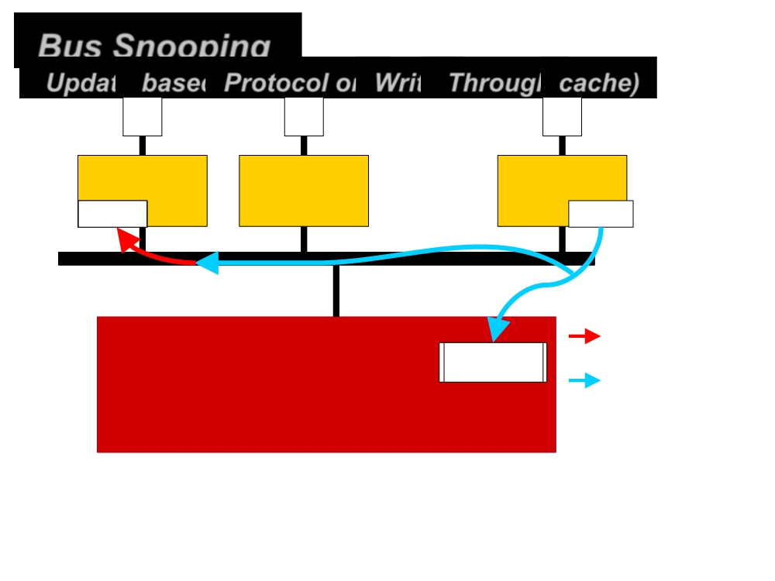
Bus Snooping
(Update-based Protocol on Write-Through cache)
P
P
P
Cache
Cache
Cache
X=
505
X= 505
Bus transaction
X= 5050
Memory
Bus snoop
• Each processor’s cache controller constantly snoops on the bus
• Update local copies upon snoop hit

Slide 35
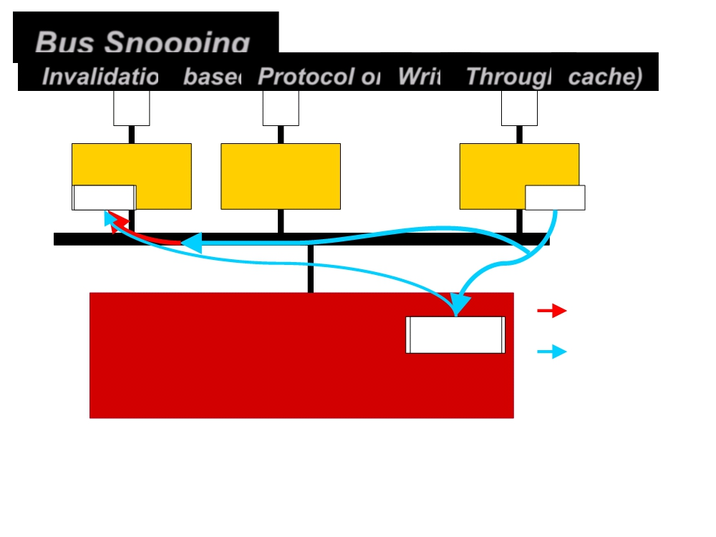
Bus Snooping
(Invalidation-based Protocol on Write-Through cache)
P
P
P
Load X
Cache
Cache
Cache
X= 505
X= 505
Bus transactio
X= 5050
Memory
Bus snoop
• Each processor’s cache controller constantly snoops on the bus
• Invalidate local copies upon snoop hit

Slide 36
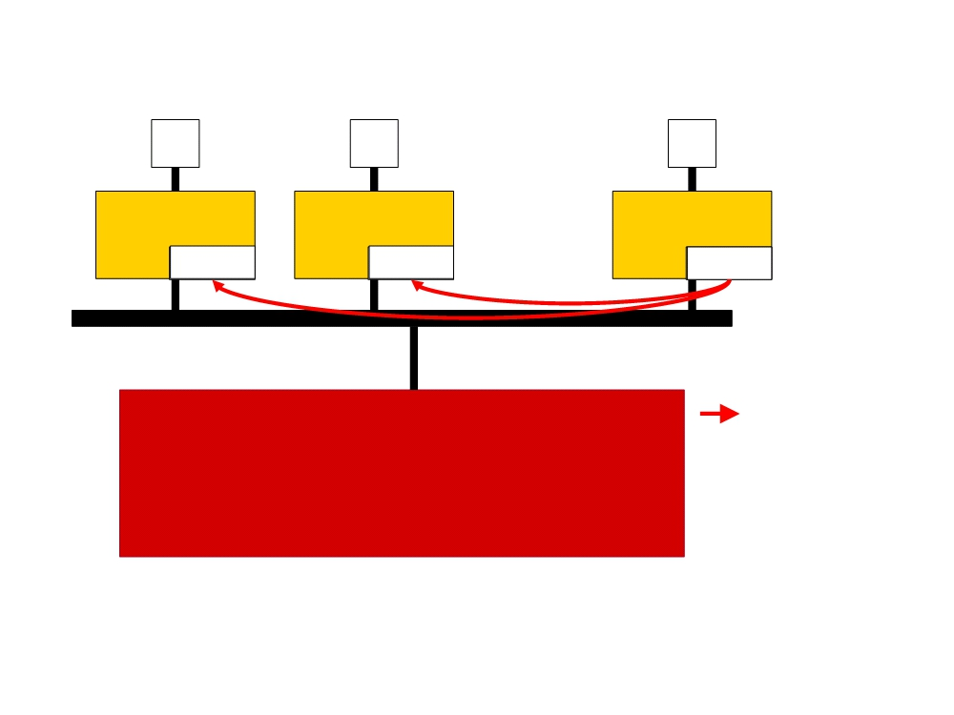
Cache Coherence Protocol
(Update-based Protocol on Writeback cache)
P
P
P
Store X
Cache
Cache
Cache
X= 505
X= 505
X=
505
update
update
Bustransaction
Memory
• Update data for all processor nodes who share the same data
• For a processor node keeps updating the memory location, a lot of traffic will be incurred

Slide 37
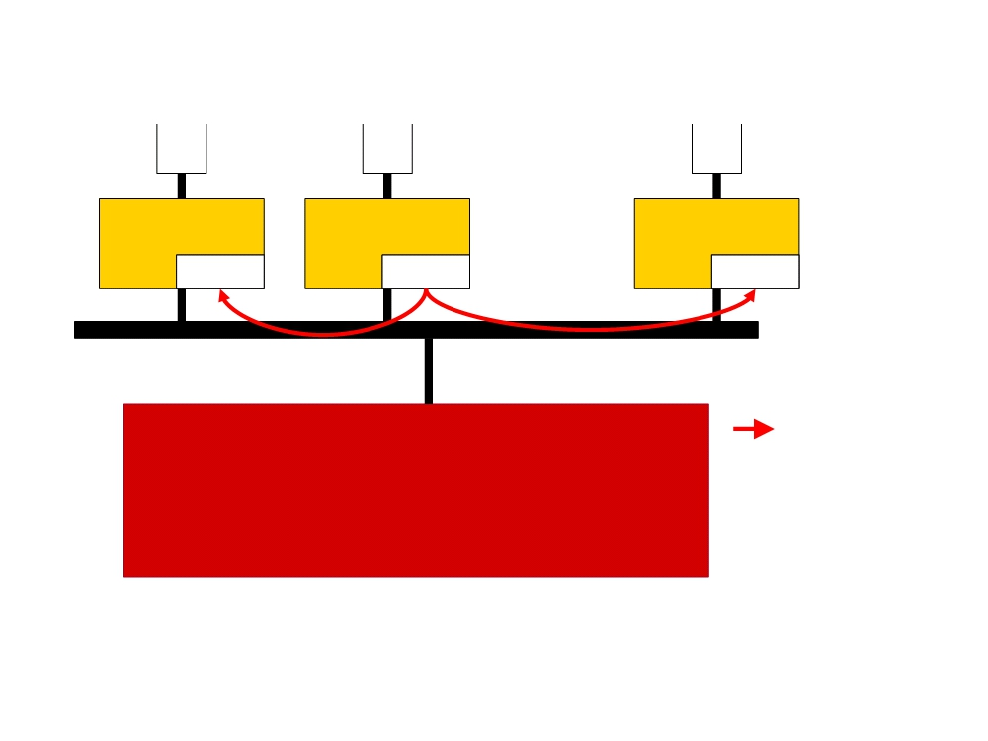
Cache Coherence Protocol
(Update-based Protocol on Writeback cache)
P P
Store X
P
Load X
Cache Cache
Cache
X= 333 X=
333
X= 333
Hit !
update
update
Bus transact
Memory
• Update data for all processor nodes who share the same data
• For a processor node keeps updating the memory location, a lot of traffic will be incurred

Slide 38
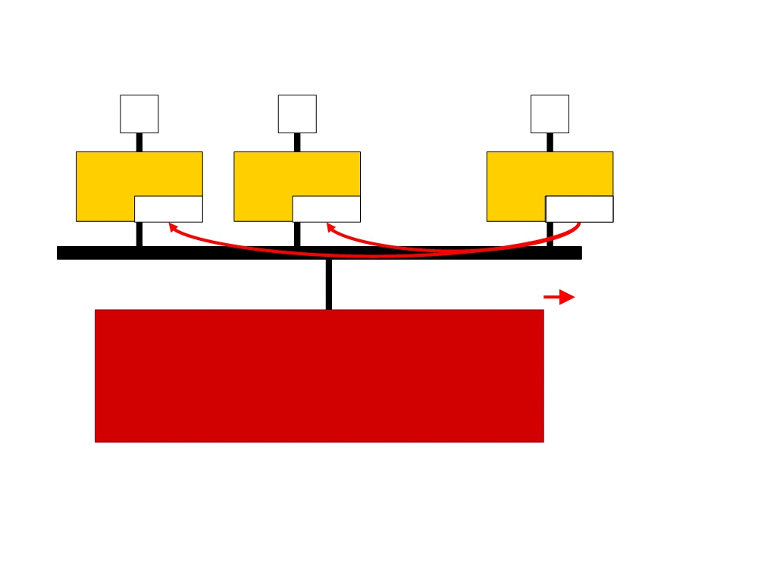
Cache Coherence Protocol
(Invalidation-based Protocol on Writeback cache)
P
P
P
Store X
Cache
Cache
Cache
X= -100
X= -100
X=
505
invalidate
invalidate
Bus transactio
Memory
• Invalidate the data copies for the sharing processor nodes
• Reduced traffic when a processor node keeps updating the same memory location

Slide 39
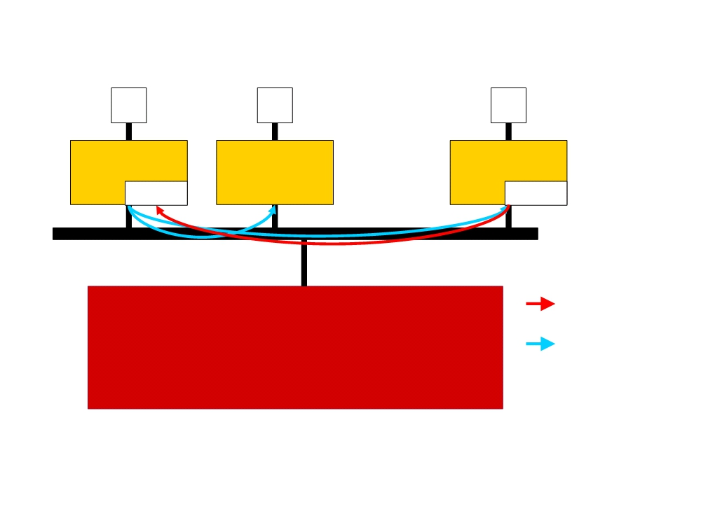
Cache Coherence Protocol
(Invalidation-based Protocol on Writeback cache)
P P P
Load X
Cache
Cache
Cache
X=
505
X=
505
Miss !
Snoop hit
Bus transact
Memory
Bus snoop
• Invalidate the data copies for the sharing processor nodes
• Reduced traffic when a processor node keeps updating the same memory location

Slide 40
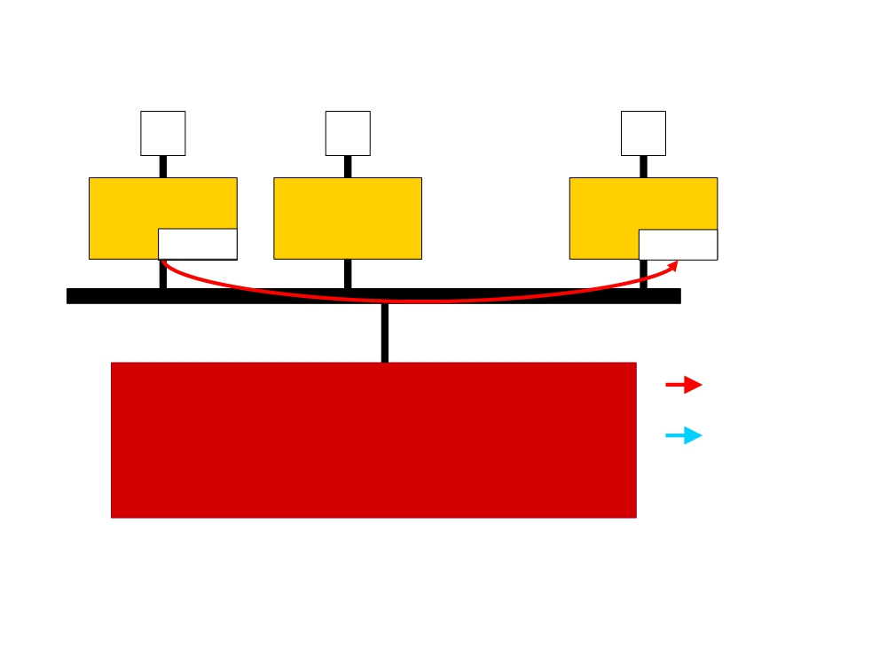
Cache Coherence Protocol
(Invalidation-based Protocol on Writeback cache)
Store X Store X Store X
P P P
Cache
Cache
Cache
X=
444
X=
505
Bus transact
Memory
Bus snoop
• Invalidate the data copies for the sharing processor nodes
• Reduced traffic when a processor node keeps updating the same memory location

Slide 41
Mapping functions
Mapping functions determine how memory blocks are placed in the cache.
A simple processor example:
Cache consisting of 128 blocks of 16 words each.
Total size of cache is 2048 (2K) words.
Main memory is addressable by a 16-bit address.
Main memory has 64K words.
Main memory has 4K blocks of 16 words each.
Three mapping functions:
Direct mapping
Associative mapping
Set-associative mapping.

Slide 42
Direct mapping
Main
Block 0
Block j of the main memory maps to j modulo 128 of
the cache. 0 maps to 0, 129 maps to 1.
More than one memory block is mapped onto the same
position in the cache.
May lead to contention for cache blocks even if the
cache is not full.
Resolve the contention by allowing new block to
replace the old block, leading to a trivial replacement
algorithm.
Memory address is divided into three fields:
- Low order 4 bits determine one of the 16
words in a block.
- When a new block is brought into the cache,
the next 7 bits determine which cache
block this new block is placed in.
- High order 5 bits or tag bits identify a memory
block when it is resident in the cache.
Simple to implement but not very flexible.
memory
Cache
Block 1
tag
Block 0
tag
Block 1
Block 127
Block 128
tag
Block 127
Block 129
T
ag
Block
W
ord
Block 255
5
7
4
Block 256
Main memory address
Block 257
Block 4095

Slide 43
Associative mapping
Main
Block 0
memory
Main memory block can be placed into any cache
position.
Memory address is divided into two fields:
- Low order 4 bits identify the word within a block.
- High order 12 bits or tag bits identify a memory
block when it is resident in the cache.
Flexible, and uses cache space efficiently.
Replacement algorithms can be used to replace an
existing block in the cache when the cache is full.
Cost is higher than direct-mapped cache because of
the need to search all 128 patterns to determine
whether a given block is in the cache.
Cache
Block 1
tag
Block 0
tag
Block 1
Block 127
Block 128
tag
Block 127
Block 129
Tag
Word
Block 255
12
4
Block 256
Main memory address
Block 257
Block 4095

Slide 44
Set-Associative mapping
Set 0
Cache
Main
Blocks of cache are grouped into sets.
Mapping function allows a block of the main
memory to reside in any block of a specific set.
Divide the cache into 64 sets, with two blocks per set.
Memory block 0, 64, 128 etc. map to block 0, and they
can occupy either of the two positions.
Memory address is divided into three fields:
- 6 bit field determines the set number.
- High order 6 bit fields are compared to the tag
fields of the two blocks in a set.
Set-associative mapping combination of direct and
associative mapping.
Number of blocks per set is a design parameter.
- One extreme is to have all the blocks in one set,
requiring no set bits (fully associative mapping).
- Other extreme is to have one block per set, is
the same as direct mapping.
memory
Block 0
tag
Block 0
Block 1
tag
Block 1
tag
Block 2
Set 1
tag
Block 3
Block 63
Set 63
Block 64
tag
Block 126
Block 65
tag
Block 127
T
ag
Set
W
ord
Block 127
6
Block 128
6
4
Main memory address
Block 129
Block 4095

Slide 45
Replacement Algorithms
Replacement algorithm determines which block in cache is removed to make room.
Least Recently Used (LRU)
The block replaced is the one unused for the longest time.
Random
The block replaced is completely random – a counter-intuitive approach.
FIFO

Slide 46
Hit Rate and Miss Penalty
Hit rate – The number of hits stated as a fraction of all attempted accesses
Miss rate - The number of misses stated as a fraction of all attempted accesses
Miss Penalty – The extra time needed to bring the desired information into the cache
Hit rate can be improved by increasing block size, while keeping cache size constant
Block sizes that are neither very small nor very large give best results.
Miss penalty can be reduced if load-through approach is used when loading new blocks into cache.

Slide 47
Caches on the processor chip
In high performance processors 2 levels of caches are normally used.
Average access time in a system with 2 levels of caches is
t _{ave} = h1c1+(1-h1)h2c2+(1-h1)(1-h2)M
Where
h1 – hit rate in the L1 cache
h2 - hit rate in the L2 cache
c1 – time to access information in the L1 cache
c2 - time to access information in the L2 cache
M – time to access information in the main memory

